Slide 1
MACRO PROCESS
SOFTWARE DEVELOPMENT LIFECYCLE

Slide 2
CONTENTS OF THIS TEMPLATE
Here’s what you’ll find in this presentation:
What is Macro process and what are its activities.
Objectives and main focuses of SDLC and their activities in each phase.
Disciplines that are executed for the SDLC phases.
Time Dimensions and their milestones.
Importance of Release Planning into the business world.

Slide 3
TABLE OF CONTENTS
01
01
01
04
05
06
OOAD Processes
OOAD Processes
OOAD Processes
OOAD Processes
OOAD Processes
What are the activities invloved within macro process
Disciplines
Macro Process Time Dimensions
Release Planning
Protocols that all the phases undergoes
Describes about each phase throughout cycle and iterations
Software product deployment to increase its business value

Slide 4
“A key principle of any effective software engineering, not only reliability-oriented engineering, simplicity is a quality that, once lost, can be extraordinarily difficult to recapture”
—Betsy Beyer

Slide 5
01
OOAD Processes

Slide 6
OOAD
Object oriented Analysis and Design (OOAD) is a technical approach which is used in the analysis and design of a software system.
OOAD is best applied iteratively since there is no particular process involved but each aspect where OOAD is applied gets refined as it gets reused.
  OOAD involves in two processes which are Macro Process and Micro process, where the Macro Process involves in Software Development Life Cycle and Micro Process deals with the Analysis and Design Phase.

Slide 7
02
Macro Process

Slide 8
Macro Process is the Software development Life Cycle (SDLC) which serves as a controlling framework for the Micro process.
In-order to develop a software we need to undergo some systematic process that ensures the quality and correctness of the software built.
The SDLC aims to produce high quality software that meets the customer expectations.
SDLC mainly focuses on how to plan, built and maintain the software.
SDLC involves in five phases where each phase has its own process and deliverables that will gets feed into the next phase.

Slide 9
03
SDLC Life Cycle

Slide 10
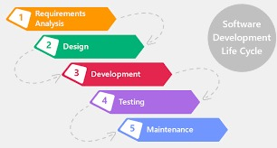

Slide 11
SDLC Phases
1. Requirements: Business Analysts collect the requirements from the customer as per the client's business need and document the requirements in Customer Requirement Specification (CRS).
2. Analysis and Design: Detailed understanding of the client's business needs, preparing System Requirement Specification(SRS) document and defining solutions based on the requirements and the SRS document.
3. Implementation: Implement, unit test, and integrate the design, resulting in an executable system.
4. Testing: Test the system whether it provides all the user required features.
5. Deployment: The developed product is available to the end users to use.

Slide 12
04
Disciplines

Slide 13
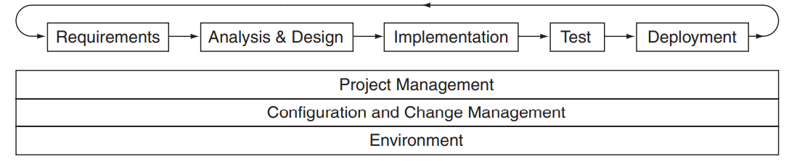
The above-provided phases represent the relative order where a software product undergoes before it reaches the customer.
The following disciplines are executed throughout the lifecycle.
Project Management
  Configuration and Change Management
  Environment
Each cycle through the disciplines contains an iteration of a macro process.

Slide 14
In an iterative and incremental macro process, the disciplines are repeated.
There must be an overall framework in which the iterations are performed that represents the strategic plan for the project and drives the goals and objectives of each of the iterations.
A satisfactory assessment allows the project to continue with the next phase to achieve the next milestone.

Slide 15
05
Macro Process Time Dimension

Slide 16
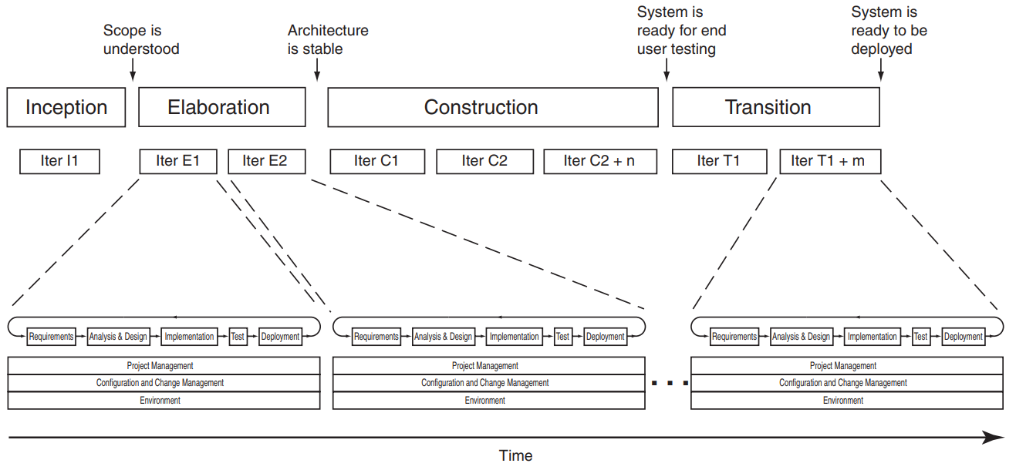
This is how milestones and iterations fit together in an iterative and incremental macro process, as well as the phases that the milestones get described .

Slide 17
Inception Phase
Purpose:
The purpose of the Inception phase is to ensure that the project has both business value and feasibility (scope).
In the early development of a software system, an idea for developing the application could be raised by any individual.
Inception is brief but still focuses on ensuring business value and technical feasibility.
Activities:
We are going to set up some requirements and prioritize the core requirements and get the customer's agreement, understand the risks, and then proceed with what development environment seems suitable.
Work Products:
The primary work products of the Inception phase are a vision of what is to be built, behavioral prototypes, an initial risk list, the identification of the key architectural mechanisms, and the development environment.
The prototypes serve as proofs of concept that the system is buildable.
The risk list identifies critical items that must be mitigated early in the lifecycle to increase the probability of success.
Milestones:
At the end of Inception Phase, we will be having a clear understanding of what we are developing, what are the risks involved in it, prioritized core requirements and a strong business reason for developing the system.
Understanding on the scope of the project.

Slide 18
Elaboration Phase
Purpose:
Once the Inception is completed then we need to develop an overall architecture framework that will help all the iterations in the system.
Our main goal is to identify architectural risks as early as possible and introduce some policies so a simpler architecture is generated.
Activities:
The Elaboration phase involves making architectural decisions, establishing the architectural framework, implementing, testing, and refining the framework based on the results of the testing.
Work Products:
Architecture is validated and creating executable architectural releases that can almost satisfy the end user key scenarios.
These scenarios test the main system features and their collaborations and also identify areas of risk.
Milestones:
Making sure the architecture is stable.
Architecture is validated against all the key system requirements including functional and non-functional requirements.
Almost all the risks have been reduced in order to predict the cost and time that are going to be consumed at the end of the system development.

Slide 19
Construction Phase
Purpose:
This phase is about when you move from thinking phase to actual production phase.
Production is a controlled methodological process of raising product quality to the point where the product can be shipped.
Activities:
This phase is based on the architecture produced in the Elaboration phase, the development of the system is completed.
Work Products:
During the iterations of the construction phase , a series of executables releases are produced that can satisfy the end user’s scenarios.
These releases can be instrumented, studied, and evaluated precisely as they incrementally grow in scope and evolve into the production system.
Milestones:
At the end of this phase, the system is ready for end-user testing when the functionality and quality are sufficient.

Slide 20
Transition Phase
Purpose:
The Transition phase is when you ensure that the software is acceptable to its end users.
Activities:
During the Transition phase, the product is made available to the user community for evaluation and testing which is most likely alpha and beta testing.
The development team then incorporates the feedback received.
The focus of Transition is on fine-tuning the product
Milestones:
By the end, the system is ready for the final deployment.
The primary measure of goodness is as same as in the Construction phase, a reduced rate of reported defects.
In this phase, early adopters are reporting the defects.
Work Products :
Producing supporting documentation, training materials, and marketing materials for the final release of the product.

Slide 21
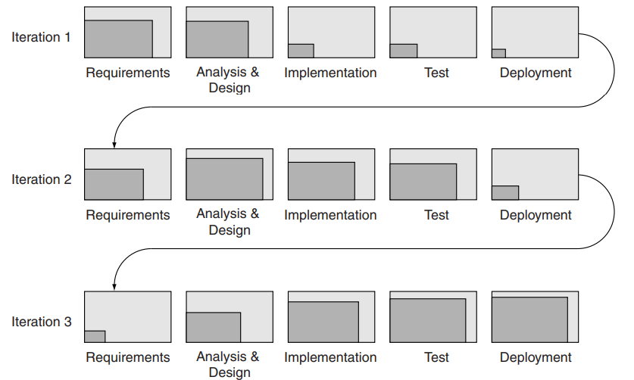
Iterations
The milestones are achieved by executing one or more iterations, and those iterations may involve activities in any or all of the disciplines.

Slide 22
The concept of an iteration is pretty much the same across most software development methods. What differs is the recommended duration for each iteration.
XP recommends that iterations be one or two weeks long, if possible.
SCRUM specifies that all iterations (sprints) should be 30 days long.
RUP recommends that iterations be two to six weeks long.

Slide 23
06
Release Planning

Slide 24
The purpose of the release planning is to identify a controlled series of releases, and in each release increase its functionality, and at the end of the produced system contains all the require requirements.
The duration of an iteration is an important factor when deciding just how much you think you can accomplish in a single iteration.
For more complex projects that require much more greater development effort, this might mean a release of extended time like 6 months or more.
More extended release schedules are not encouraged because they may hide areas of risk that are being intentionally or unintentionally ignored.
We need to prioritize the system requirements to be delivered in each release so that the performance of the system couldn't degrade.

Slide 25
Requirements are prioritized based on a number of factors. These factors may include the following:
Benefit to stakeholders (e.g., how important the requirement is to the end user, or how important it is to demonstrate a consistent part of the system functionality to the project’s sponsor).
Architectural impact and coverage (e.g., whether the requirement involves key aspects of the architecture such as access to databases, integration with legacy systems, and so on).
Risks mitigated by addressing the requirement (e.g., whether the requirement includes access to an external system whose interface is not well understood).

Slide 26
THANK YOU
SRIKAR
P-245

